Slide 1
Generative Models

Slide 2








Generative Models vs. Discriminative Models
Discriminative models Generative models
Features
Class
Noise Class
Features

Slide 3
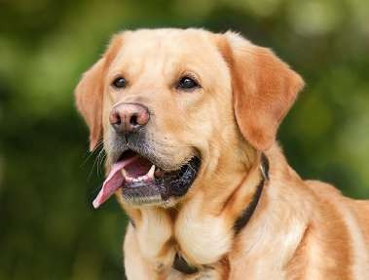
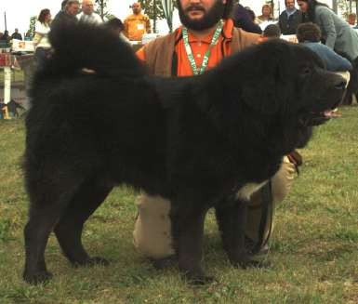
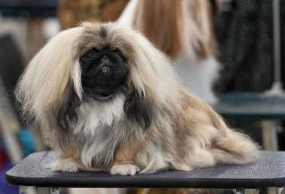
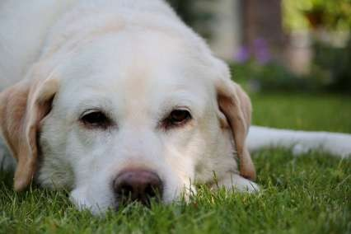
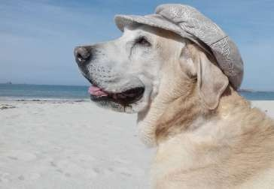
Generative Models vs. Discriminative Models
Discriminative models
Features Class
Generative models
Noise Class
Features

Slide 4
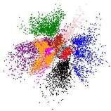
Generative Models
Variational Autoencoders
Latent Space
Encoder
Decoder
Latent Space
Decoder
Available from: https://arxiv.org/abs/1804.00891

Slide 5

Generative Models
Variational Autoencoders
Latent Space
Encoder Decoder
Latent Space
Decoder
Generative Adversarial Networks
Compete
Generator
Discriminator
Generator
Random
Available from: https://arxiv.org/abs/1804.00891

Slide 6
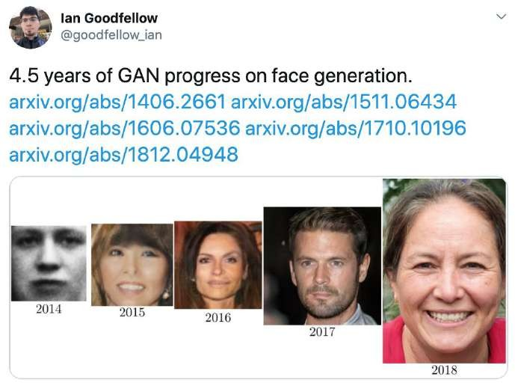
GANs Over Time
2014
Black and white
Colored photo-realistic
2018

Slide 7

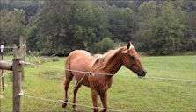
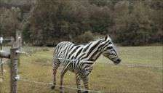
GANs for Image Translation
From one domain to another
CycleGAN
Park, Taesung, et al. "Semantic image synthesis with spatially-adaptive normalization." Proceedings of the IEEE Conference on Computer Vision and Pattern Recognition. 2019.

Slide 8



GANs for Image Translation
GauGAN
Doodles
Pictures
Park, Taesung, et al. "Semantic image synthesis with spatially-adaptive normalization." Proceedings of the IEEE Conference on Computer Vision and Pattern Recognition. 2019.

Slide 9
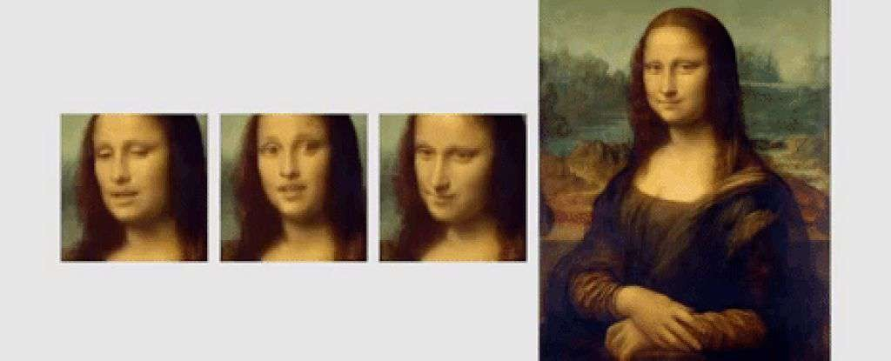
GANs are Magic!
Zakharov, Egor, et al. "Few-shot adversarial learning of realistic neural talking head models." Proceedings of the IEEE International Conference on Computer Vision. 2019.

Slide 10
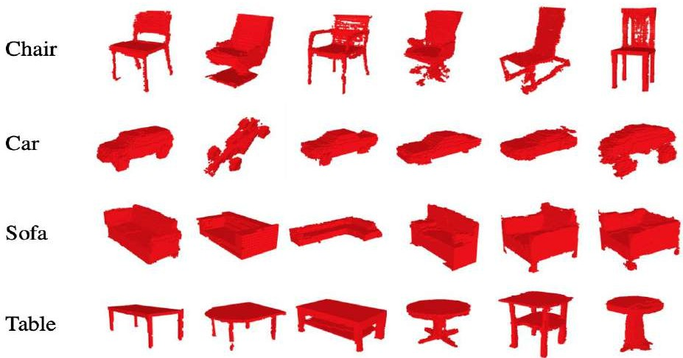

GANs for 3D Objects
3D-GAN
Generative Design
Wu, Jiajun, et al. "Learning a probabilistic latent space of object shapes via 3d generative-adversarial modeling." Advances in neural information processing systems. 2016.

Slide 11





Companies Using GANs
Next-gen Photoshop
Text Generation
Data Augmentation
Image Filters
Super-resolution

Slide 12
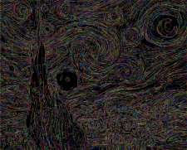
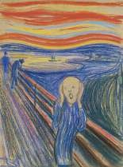
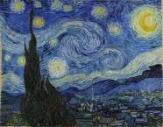
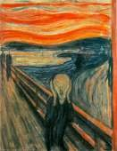
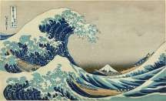
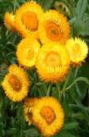

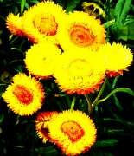
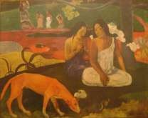
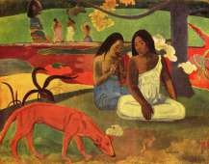
Generative Adversarial Network
Generator learns to make fakes Discriminator learns to distinguish that look real real from fake

Slide 13
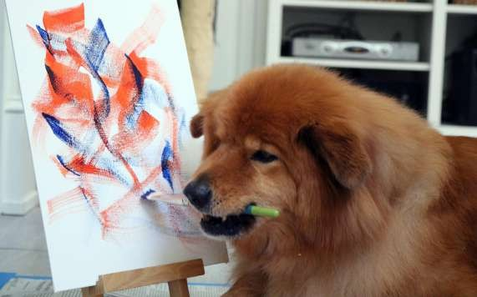
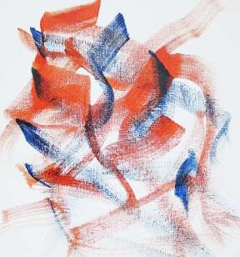
Generative Adversarial Network
Generator learns to make fakes
that look real
Doesn’t know how it should look
I don’t know what I’m doing

Slide 14
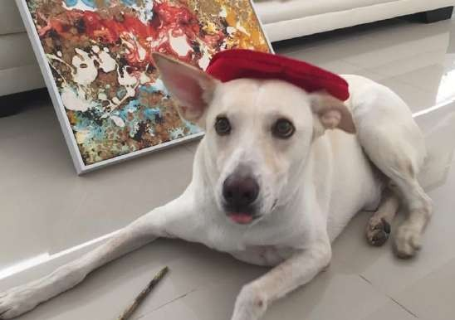
Generative Adversarial Network
Discriminator learns to distinguish
real from fake
I don’t know what I’m doing, either

Slide 15

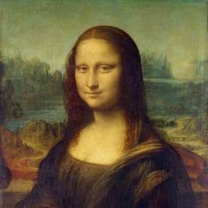

The Game Is On!
5% Real
80% Real
40% Real

Slide 16




The Game is On!
Better try something similar
5% Real
40% Real

Slide 17
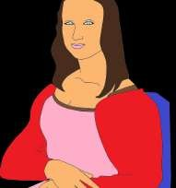
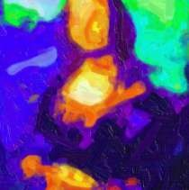
The Game Is On!
30% Real
60% Real
95% Real

Slide 18


The Game Is On!
Won’t fool me again
30% Real 60% Real 95% Real
60% Real
Wrong!

Slide 19

The Game Is On!
Very good fakes
End of
game!

Slide 20
Discriminator
deeplearning.ai

Slide 21
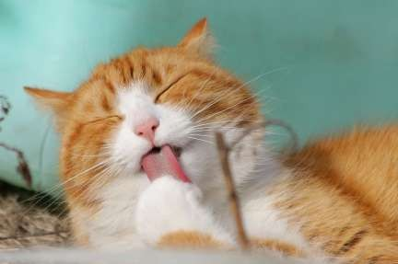
Classiﬁers
Turtle
Distinguish between different classes
Bird
Classiﬁer
Cat
Dog
Fish

Slide 22
Classiﬁers
Turtle
Distinguish between different classes
Bird
“It meows, and plays with yarn”
Classiﬁer
Cat
Dog
Fish

Slide 23





Neural Networks

Slide 24
Neural Networks
0.45 Cat
0.45 Dog
0.10 Bird

Slide 25
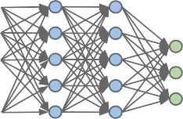



Classiﬁers (training)
Parameters
Cost
Output vs Label
Features
Output
Discriminator
Labels

Slide 26

Classiﬁers
Turtle
Bird
Cat
Dog
Fish

Slide 27


Classiﬁers
Conditional Probability
Class
Features

Slide 28

Discriminator
0.45 Cat
0.45 Dog
0.10 Bird

Slide 29
Discriminator
0.45 Cat
0.45 Dog
0.10 Bird
0.85 Fake

Slide 30
Discriminator
Fake
Class
Features

Slide 31

Discriminator
Fake
Fake
Class
Features

Slide 32
Generator
deeplearning.ai

Slide 33
Generator
Turtle
Generates examples of the class
Bird
Generator
Cat
Dog
Fish

Slide 34
Neural Networks
Noise (random features)

Slide 35
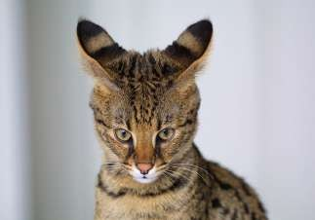
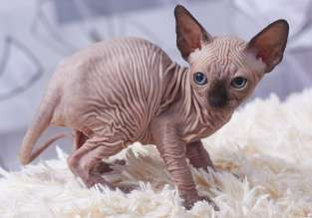
Neural Networks
Different outputs at every run!
Noise (random features)

Slide 36
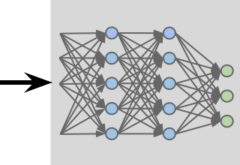
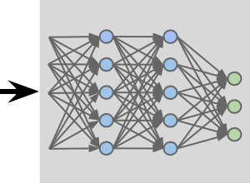



Generator: Learning
Parameters
Noise
Cost
Output
Features
Output
Generator
Discriminator

Slide 37
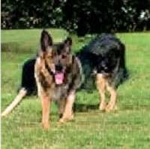
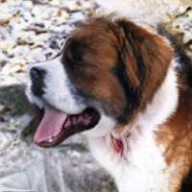
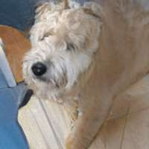
Sampling
Saved Generator

Slide 38
Generator
Turtle
Bird
Cat
Dog
Fish

Slide 39
Generator
Conditional Probability
Features
Class

Slide 40
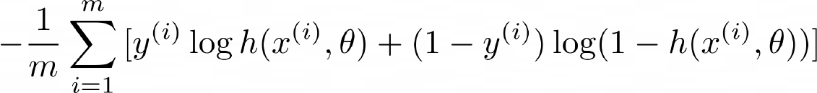

BCE Cost Function
Prediction
Label
Features
Average loss of the whole batch
Parameters

Slide 41
BCE Cost Function

Slide 42

BCE Cost Function
0
any
0
1
1
0.99 ~0
~0 -inf
Relevant when the label is 1

Slide 43
BCE Cost Function
1
any
0
0
0
0.01 ~0
~1 -inf
Relevant when the label is 0

Slide 44
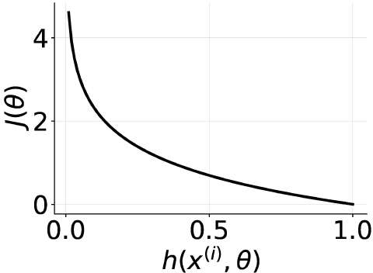
BCE Cost Function

Slide 45
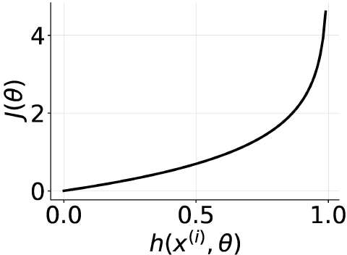
BCE Cost Function

Slide 46

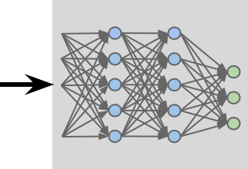
GANs Model
Reals
Output
Discriminator
Noise
Distinguish the fakes
and the reals
Make the fakes look like the reals
Fakes
Generator

Slide 47


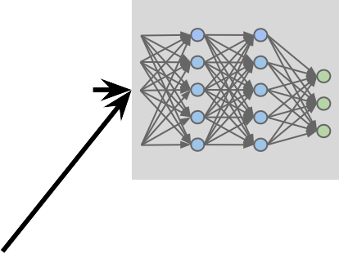
Training GANs: Discriminator
Both real and fake examples
Parameters Discriminator
Noise
Cost
Output
Features
Output
Generator
Discriminator
BCE with labels for real and fake

Slide 48


Training GANs: Generator
Parameters Generator
Noise
Cost
Output
Features
Output
Generator
Only fake examples
Discriminator
BCE with all labels equal to real

Slide 49
Training GANs
Discriminator Output
Fakes as 100% fake
Superior Discriminator
No way to improve

